Slide 1
China Market Tracking Report for
BMS Pipeline
11Q1
MR&BI
June. 2011

Slide 2
Summary (I)
China Market situation
  In MAT11Q1, the total China Market got 48.7 Billion USD, and BMS 10 key Therapy* area reached 10.2B USD value sales (20.9% of total China market), and 25.0% annual growth vs. MAT10Q1, higher than total China Pharmaceutical market growth (22.4%). Also It is more rapid average growth (34.0%) market of BMS 10 key Therapy area in China vs. total China market growth (32.2%) among the last 5 years . While Tier3 hospitals achieved 12.9B USD (26.5% of total China Market), and its hospitals annual growth rate (27.7%) was below China Market and BMS 10 focus.
  Compared with MAT 10Q1, most of China growth was linked to volume (contributed 95% of total growth), very small growth from new products (only 21.4% of total growth value) , products’ price cut had 4.4% negative impact on the total value growth in MAT11Q1.
BMS Related Pipeline Market
  In MAT11Q1, the market growth of ACS (33.4%), AF& VTE/P (31.3%), AD(27.1%),CML (41.7%), HCV(23.5%), and RA (40.5%) in China are higher than the total China market (22.4%) vs. MAT10Q1, while the market of NIAD(21.3%) and HCC (-2.5%) are below the total.
  In MAT11Q1, the ACS market reached 654.6 M USD value sales and 13.6% sales coming from Tier 3 hospitals. Plavix still dominated the market as 45.1% share and 38.0% growth. The top3 using ACS treatment molecular Dept. are Cardi, Neuro and IM.
  In MAT11Q1, AF&VTE/P Market in China got 336.9M USD value sales and 30.7% coming from Tier 3 hospitals. In Tier3 hospitals, Fraxiparine kept the No.1 value brand as 23% share. For Xarelto, it reached 3.9% of value share in Tier3 hospitals and 2.4% nationally only after 7 quarters launched. In Tier3 hospitals The Cardi and Cardi_Surg are among the top3 Rx department and account~40% prescription share.

Slide 3
Summary (II)
  BMS Related Pipeline Market
  In MAT11Q1, Alzheimer Disease Market in China reached 33.5M USD value sales, 36.1% contributed by Tier 3 hospitals. Aricept still dominate the market as 49.7% share , and Ebixa is the second share brand (14.1%) with the highest annual growth rate (61.4%). The Neuro is the No.1 Rx department for prescribing AD treatment molecular.
  In MAT11Q1, CML Market in China reached 33.6M USD value sales, Tier3 dominated the treatment as 61.0% value share. Random Ward (38%) and Hemato (45%) dominated the Glivec prescription in Beijing and Guangzhou respectively, while in Shanghai, Onco_Surg accounted for 53% prescription share in MAT11Q1.
  In MAT11Q1, HCV Market in China reached 93.4M USD value sales, 42.8% coming from Tier3 hospitals. Pegasys still dominated the market as 84.6% share and 28.2% growth. The Infection is the No.1 Rx department for prescribing HCV treatment molecular.
  In MAT11Q1, NIAD Market in China got 693.4M USD value sales, 22.3% coming from Tier3 hospitals. AMARYL had the highest growth rate (50.9%) in NIAD market, and Glucobay was still the leading brand as 28.7% of market share. The top3 using NIAD treatment molecular Dept. are Endo, Cardi and IM.
  In MAT11Q1, RA Market in China had 51.9M USD value sales, 52.6% coming from Tier3 hospitals. Yi Sai Pu was the No.1 brand (67.9% of value share), while Remicade had the best annual growth rate (46.2%). The main Dept. for RA treatment molecular is Rheumatology.
  In MAT11Q1, HCC TKI Market in China reached 17.1M USD value sales, 55.0% values coming from Tier3 Hospitals. Nexavar is the only brand in HCC TKI treatment.

Slide 4
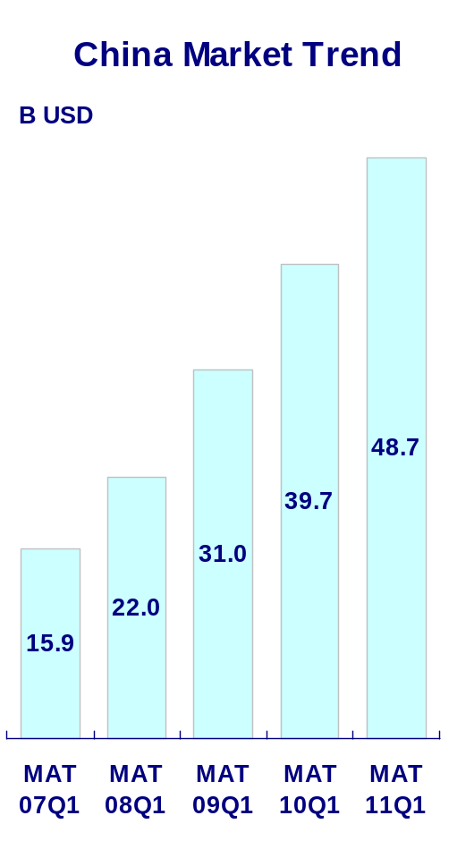
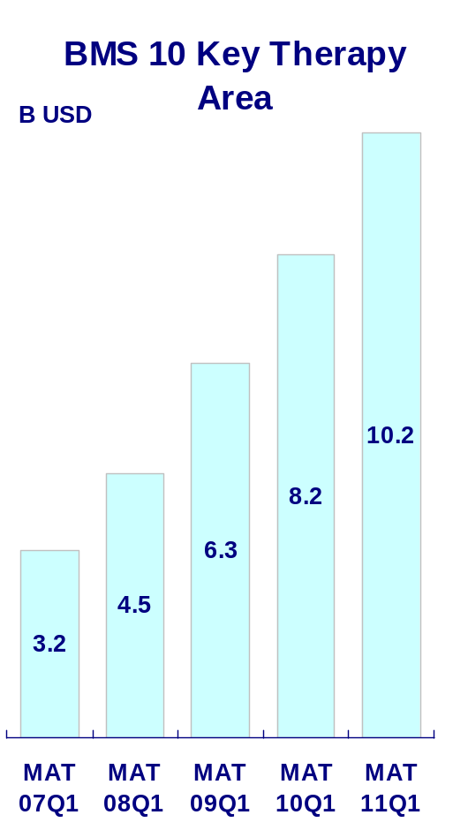
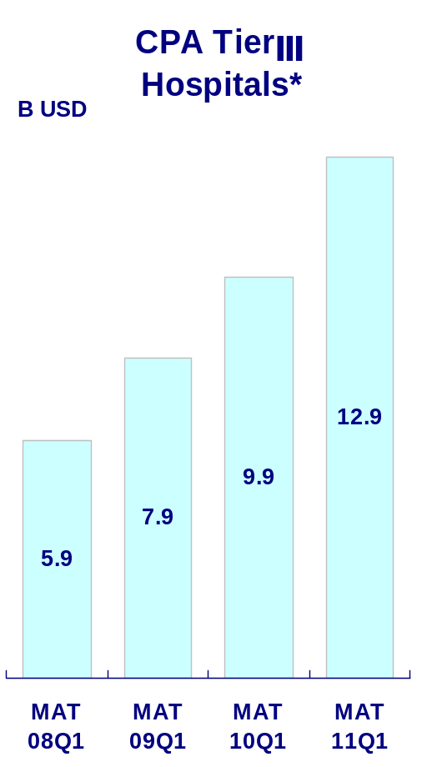
IMS&CPA Data
China Market Trend
It was rapid growth market of BMS 10 key Therapy area in China among last 5 years. In MAT11Q1, BMS 10 key Therapy area reached 10.2B USD value sales (20.9% of total China market), and 25.0% annual growth vs. MAT10Q1, higher than total China Pharmaceutical market growth (22.4%). CPA TierⅢ Hospitals got 30.2% compound growth (MAT 11Q1 vs. MAT 10Q1), and was higher than China total market (22.4%) and BMS focus therapy (25.0%) in the same period.
+22.4%
+25.0%
CAGR(MAT 08Q1-MAT 11Q1): +27.7%
+30.2%
CAGR(MAT 07Q1-MAT 11Q1): +32.2%
CAGR(MAT 07Q1-MAT 11Q1): +34.0%
+28.4%
+29.3%
+25.2%
+40.9%
+41.7%
+34.8%
+38.1%
+40.7%
Source: IMS and CPA 11Q1 *: Only select TierⅢ hospitals of CPA

Slide 5
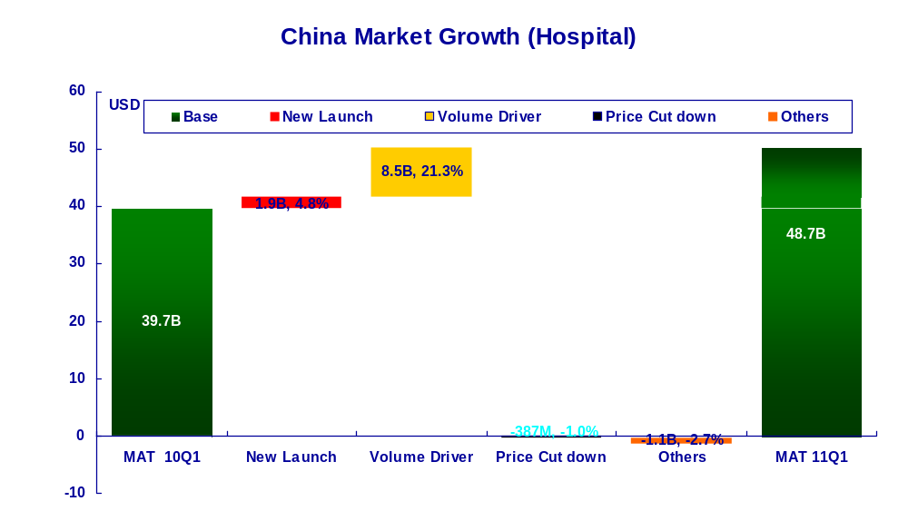
IMS Data
China Market Growth
Compared MAT 11Q1 with MAT 10Q1, most of China growth was linked to volume (contributed 95% of total growth), a small part of growth from new products (21.4% of total growth value) , products’ price cut had 4.4% negative impact on the total value growth.
22.4% increase
Data Source: IMS 11Q1 CHPA
New Launch refer to MNC products launched during 08Q1-11Q1

Slide 6
ACS

Slide 7
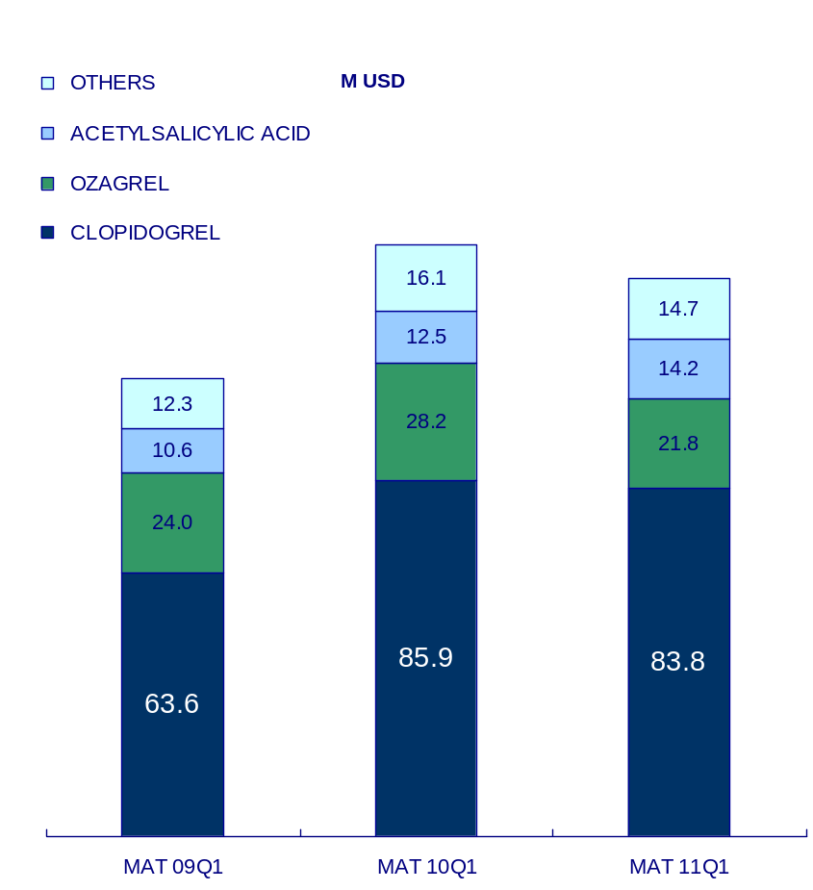
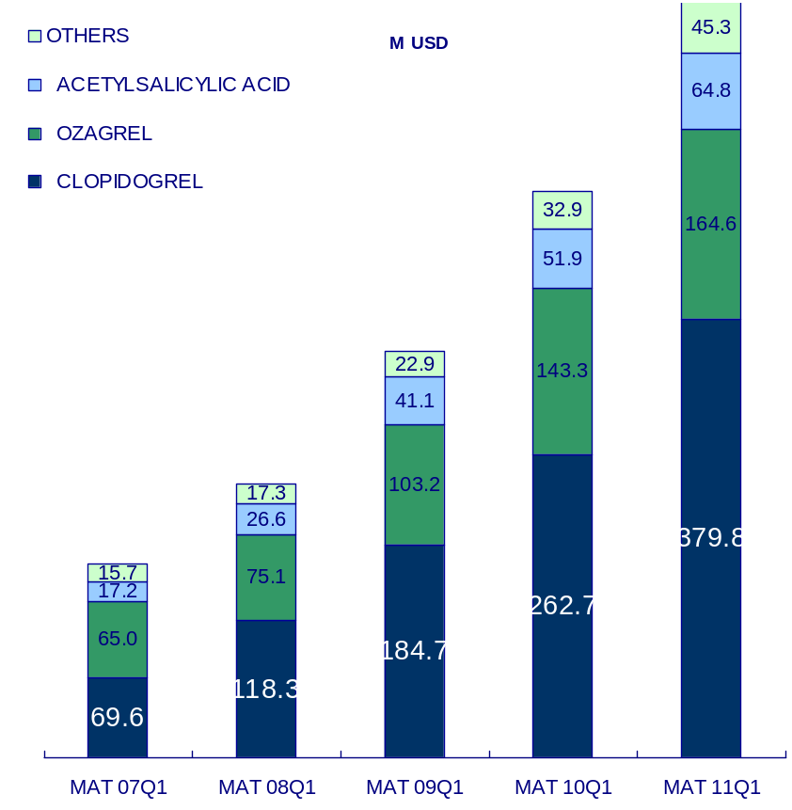
IMS&CPA Data
ACS Market National View
ACS Market in China kept higher growth (40.6%) than China market growth (32.2%) in the last 5 years. In MAT11Q1, it reached 654.6M USD value sales, and 33.4% annual growth vs. total China Pharma market growth 22.4%. TierⅢ Hospitals achieved 168.7 M USD sales (27.4% of ACS market) and 25.1% MAT growth rate in 10Q4, which was lower than that of total ACS market.
IMS
654.6
*TierⅢ Hospitals
+33.4%
CAGR(MAT 09Q1-MAT 11Q1): +13.6%
490.8
134.8
168.7
-5.7
+39.5%
CAGR(MAT 07Q1-MAT 11Q1): +40.6%
104.0
+29.1%
351.9
+48.3%
有的Category没有11Q1数据
237.2
+41.7%
167.4
*TierⅢ hospitals= CPA
Source: IMS and CPA 11Q1 Market definition: B01C (PLATELET AGGREG INHIBITRS)

Slide 8
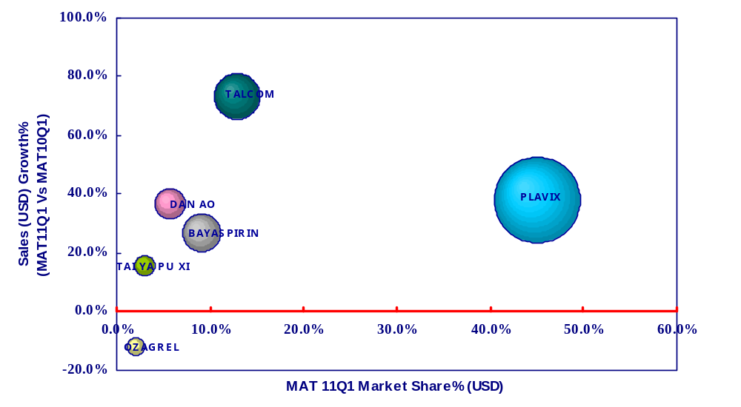
IMS Data
ACS Market National View
In MAT11Q1, TALCOM (73.4%), DAN AO (36.6%) and Plavix (38.0%) growth rate exceeded the average market growth (33.4%) of the ACS treatment molecular.
字体放大
Ave Mkt Growth:+33.4%
Source: IMS CHPA 11Q1 Market definition: B01C (PLATELET AGGREG INHIBITRS)

Slide 9
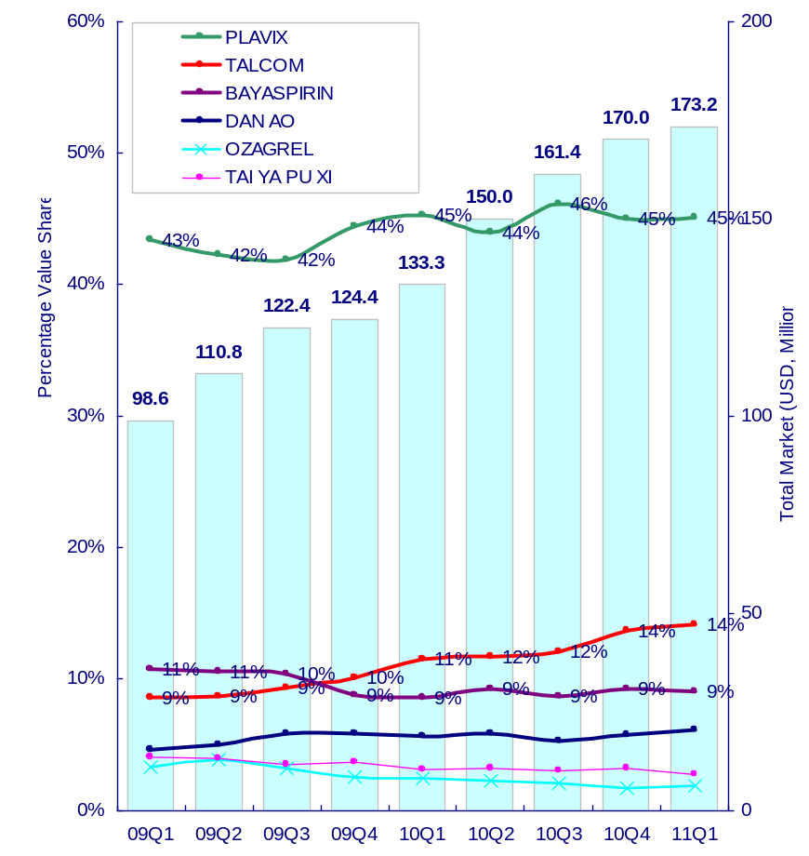
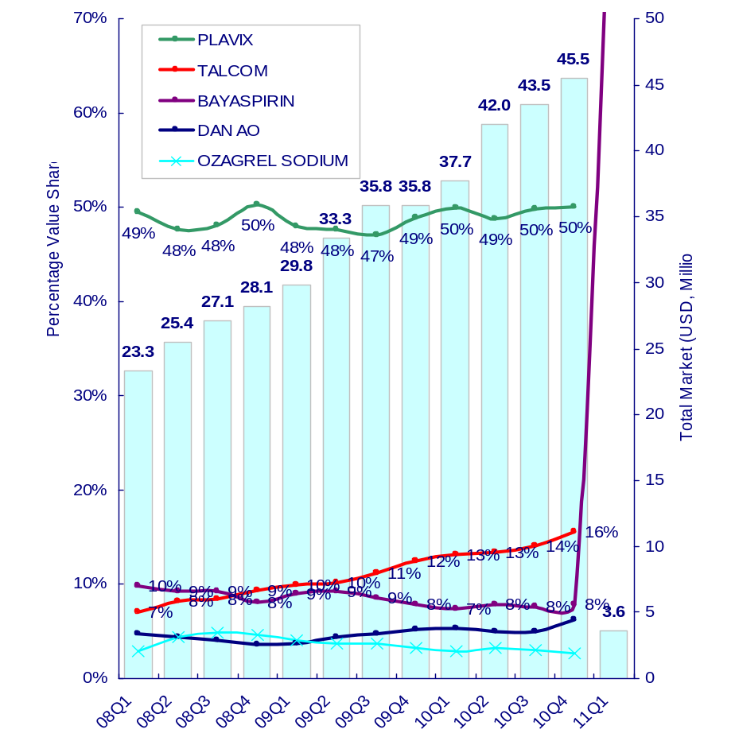
IMS&CPA Data
ACS Market National View
From the product view, Plavix still dominated China ACS market both in IMS and CPA as 45% value share and 50% value share respectively in 11Q1.
IMS
*TierⅢ Hospitals
有的Category没有11Q1数据
*TierⅢ hospitals= CPA
Source: IMS and CPA 11Q1 Market definition: B01C (PLATELET AGGREG INHIBITRS)

Slide 10
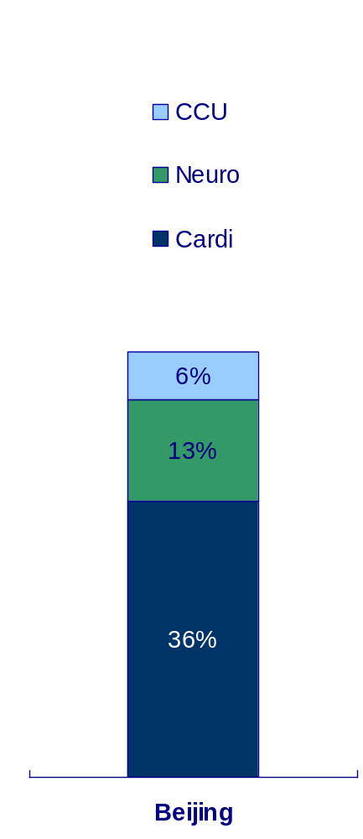
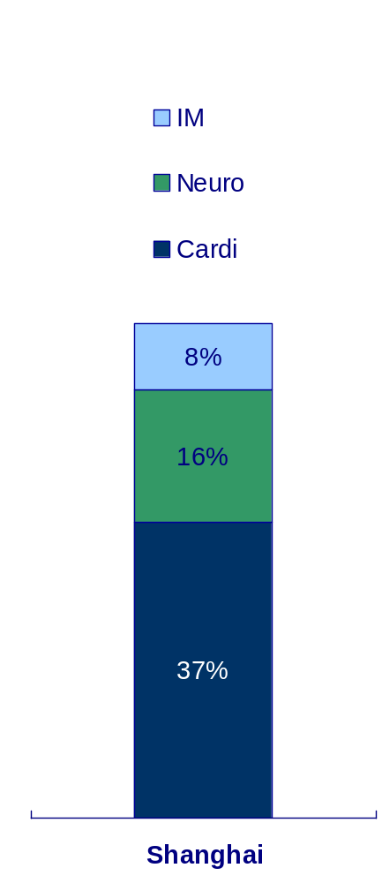
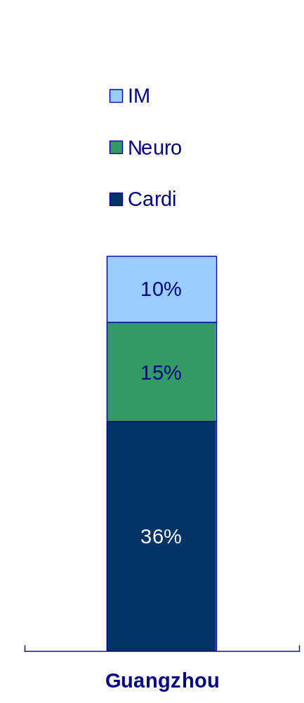
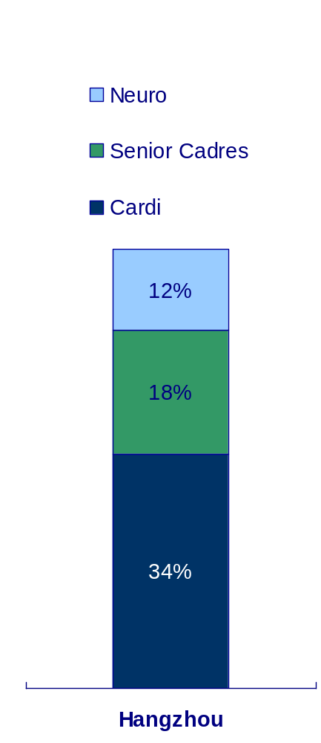
Rx. Data
ACS Treatment Molecular Rx View --- by Prescription
From the prescription data in sample hospitals of BJ, SH, GZ & HZ, the top Deps. using ACS treatment molecular were Cardi, Neuro and IM.
未更新
Source: Rx MAT 10Q4 Market definition: B01C (PLATELET AGGREG INHIBITRS)

Slide 11
Rx Indication Data
ACS Treatment Molecular Rx- ratio in ACS indication
Molecule | Beijing, Guangzhou, Hangzhou | Shanghai
ACETYLSALICYLIC ACID | 0.0% | 2.4%
BERAPROST | 0.0% | 0.0%
TIROFIBAN | 31.0% | 0.0%
CLOPIDOGREL | 2.0% | 0.0%
SARPOGRELATE | 0.0% | 0.0%
OZAGREL | 0.2% | 0.1%
CILOSTAZOL | 0.5% | 0.0%
TICLOPIDINE | 0.0% | 0.0%
SULODEXIDE | 0.0% | 0.0%
BATROXOBIN | 0.0% | 0.0%
Source: Rx Indication MAT09Q4

Slide 12
AF&VTE/P

Slide 13
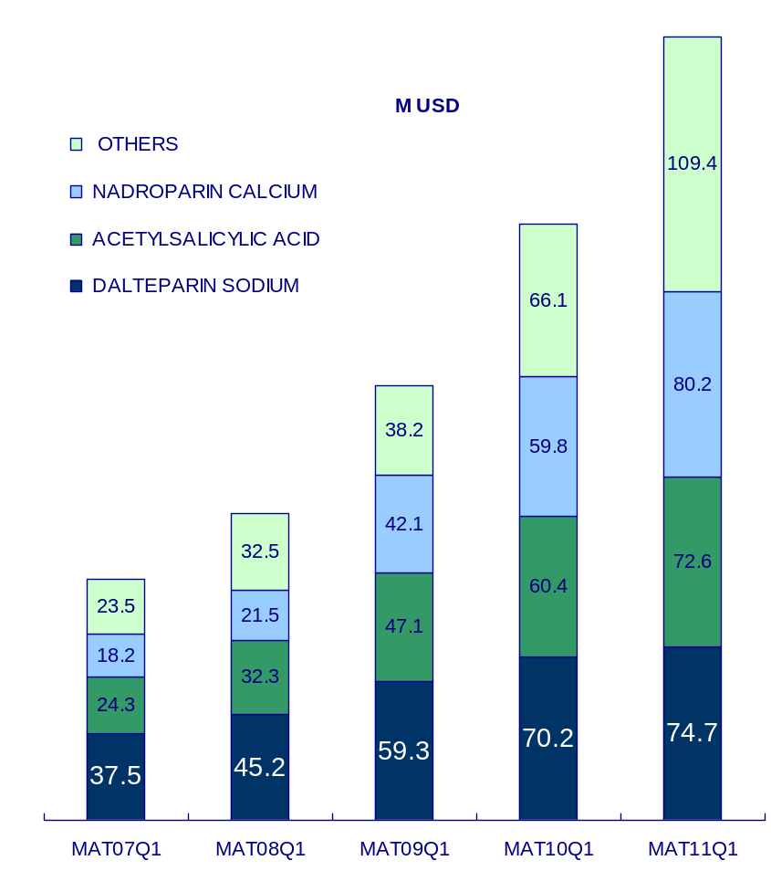
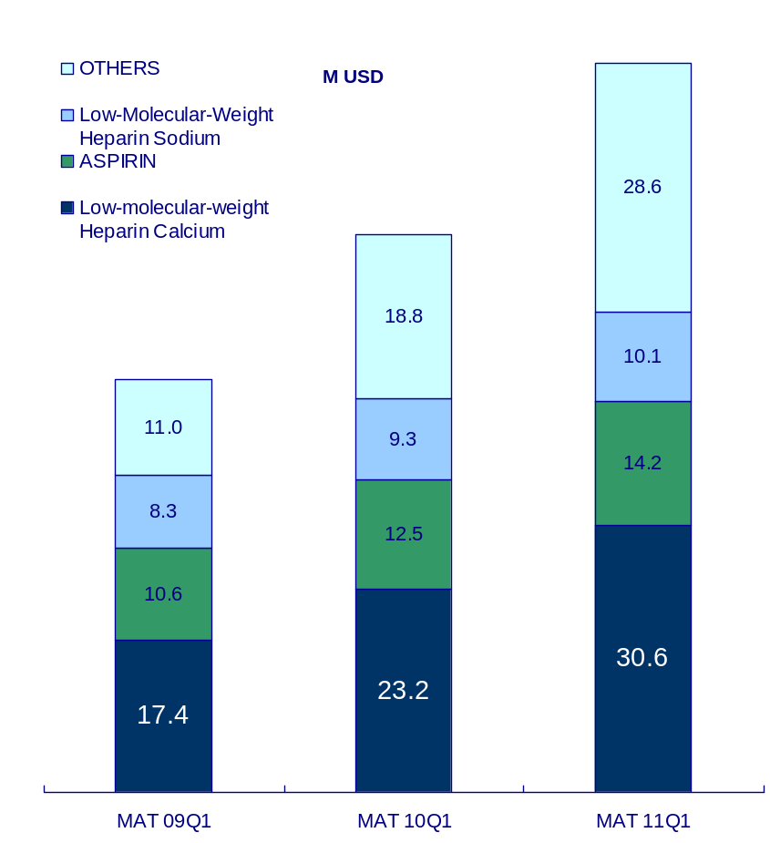
IMS&CPA Data
AF&VTE/P Market National View
AF&VTE/P Market in China kept higher growth (34.3%) than China market growth(32.2%) in the last 5 years. In MAT11Q1, it reached 336.9M USD value sales, and 31.3% annual growth vs. total China Pharma market growth 22.4%. Tier Ⅲ Hospitals achieved 83.5M USD sales (24.8% of AF&VTE/P market) and 30.7% MAT growth rate, which was lower than that of total AF&VTE/P market.
IMS
336.9
*TierⅢ Hospitals
83.5
+31.3%
+30.7%
256.5
CAGR(MAT 09Q1-MAT 11Q1): +32.9%
63.9
CAGR(MAT 07Q1-MAT 11Q1): +34.3%
+37.3%
+35.2%
186.8
47.3
+42.0%
131.5
+27.0%
103.6
Source: IMS and CPA 11Q1 Market definition: Target Therapy
*TierⅢ hospitals= CPA

Slide 14
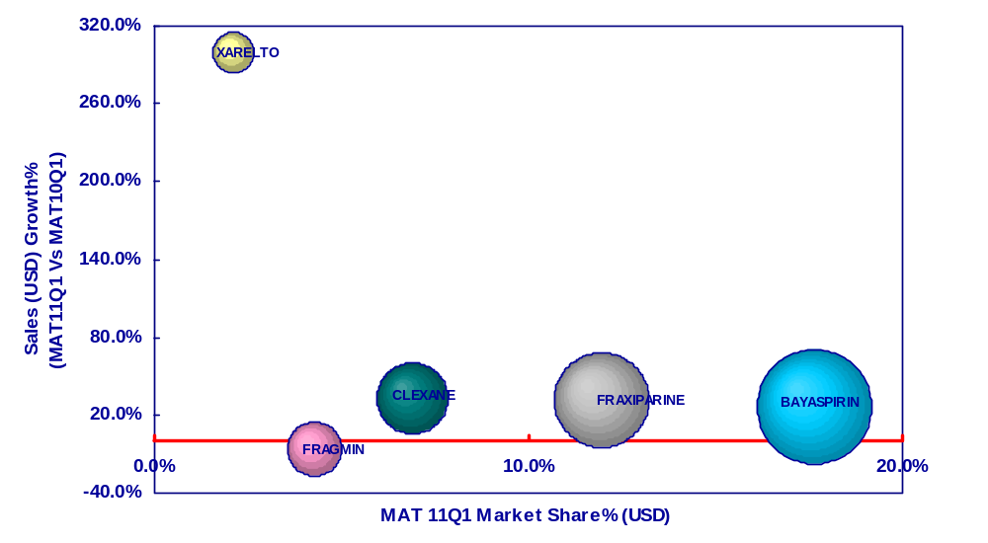
IMS Data
AF&VTE/P Market National View
In MAT11Q1, CLEXANE(33.3%)’s growth rate exceeded AF&VTE/P average market growth (31.3%), and Bayaspirin was the No.1 brand (26.9%) in the market.
Ave Mkt Growth:+31.3%
Source: IMS CHPA 11Q1 Market definition: Target Therapy

Slide 15
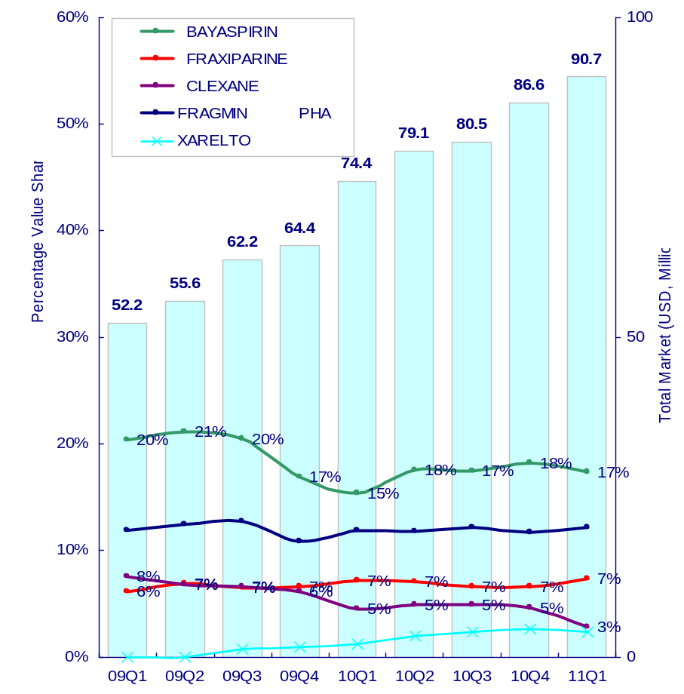
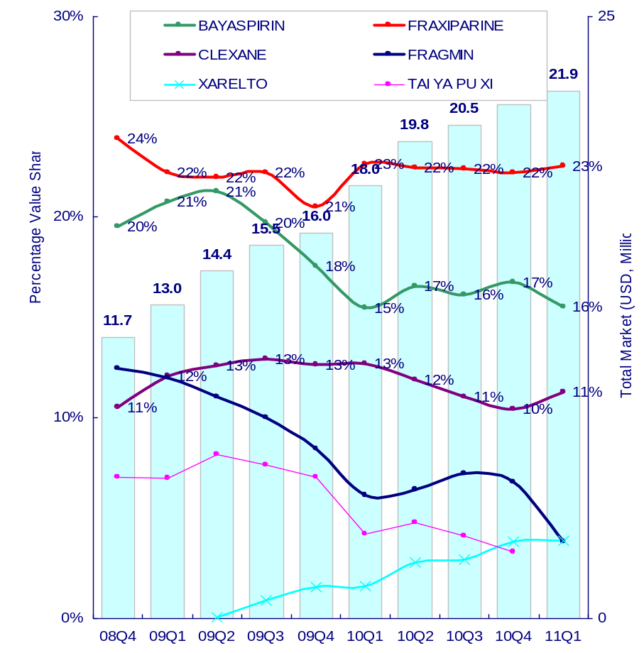
IMS&CPA Data
AF&VTE/P Market National View
From the product view, Bayaspirin got 17.4% value share of total AF&VTE/P market in 11Q1. In TierⅢ hospitals, Fraxiparine was the No.1 brand (22.5%), while Bayaspirin got 15.5% value share as No.2 brand. For Xarelto, its share mainly came form Tier Ⅲ hospitals, and it got 3.9% value share in TierⅢ and 2.4% nationally.
IMS
*TierⅢ Hospitals
*TierⅢ hospitals= CPA
Source: IMS and CPA 11Q1 Market definition: Target Therapy

Slide 16
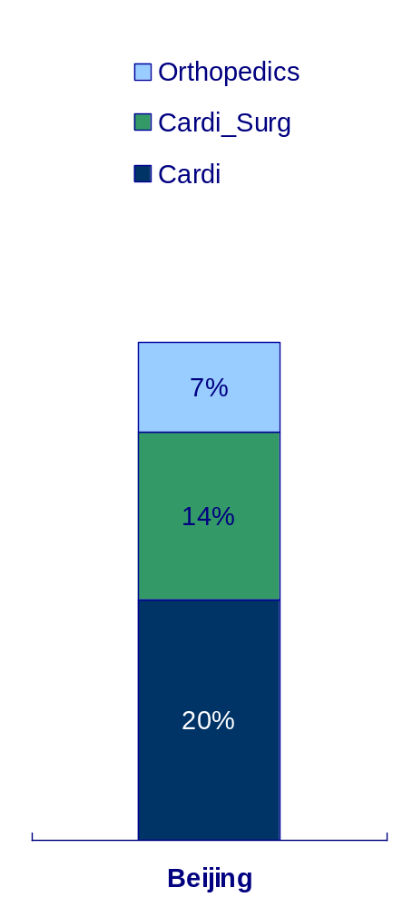
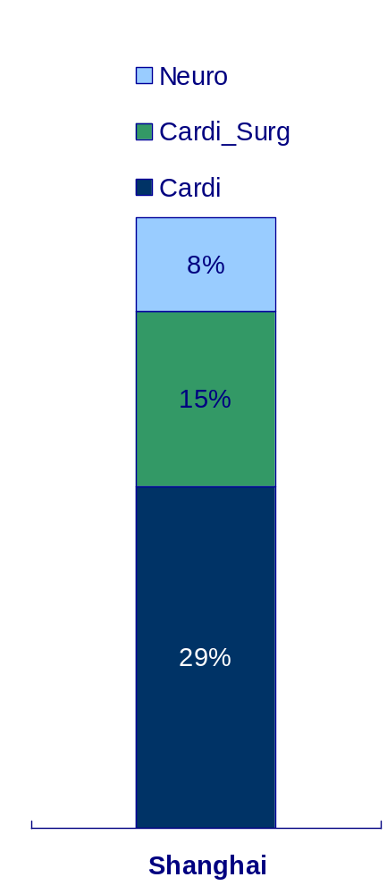
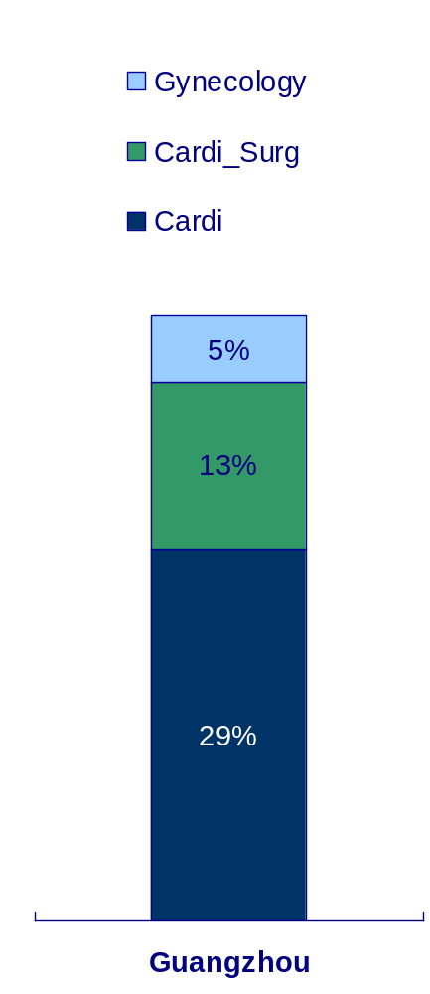
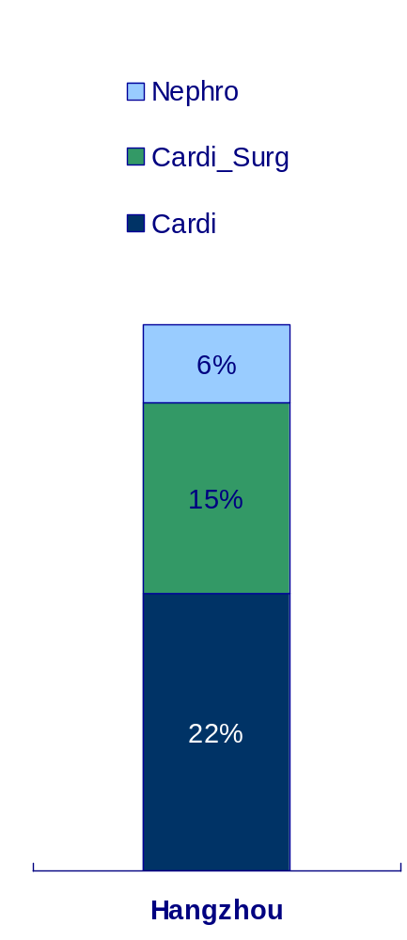
Rx. Data
AF&VTE/P Treatment Molecular Rx View --- by Prescription
From the prescription data in sample hospitals of BJ,SH, GZ & HZ, Cardi and Cardi_Surg were the top2 department and accounted for ~40% prescription share.
未更新
Tinzaparin and Dabigatran not Launch
Source: Rx MAT 10Q4 Market definition: Target Therapy

Slide 17
Rx Indication Data
Treatment Molecular Rx- ratio of target diagnosis AF& VTE/P
Molecule | Beijing, Guangzhou, Hangzhou | Shanghai
ACETYLSALICYLIC ACID | 0.1% | 0.3%
HEPARIN | 0.1% | 0.1%
WARFARIN | 4.8% | 3.9%
NADROPARIN CALCIUM | 3.7% | 2.5%
NADROPARIN CALCIUM | 2.3% | 1.0%
ENOXAPARIN SODIUM | 3.0% | 0.0%
TICLOPIDINE | 0.7% | 0.1%
RIVAROXABAN | 100% | 50%
Source: Rx Indication MAT09Q4

Slide 18
Alzheimer’s Disease

Slide 19
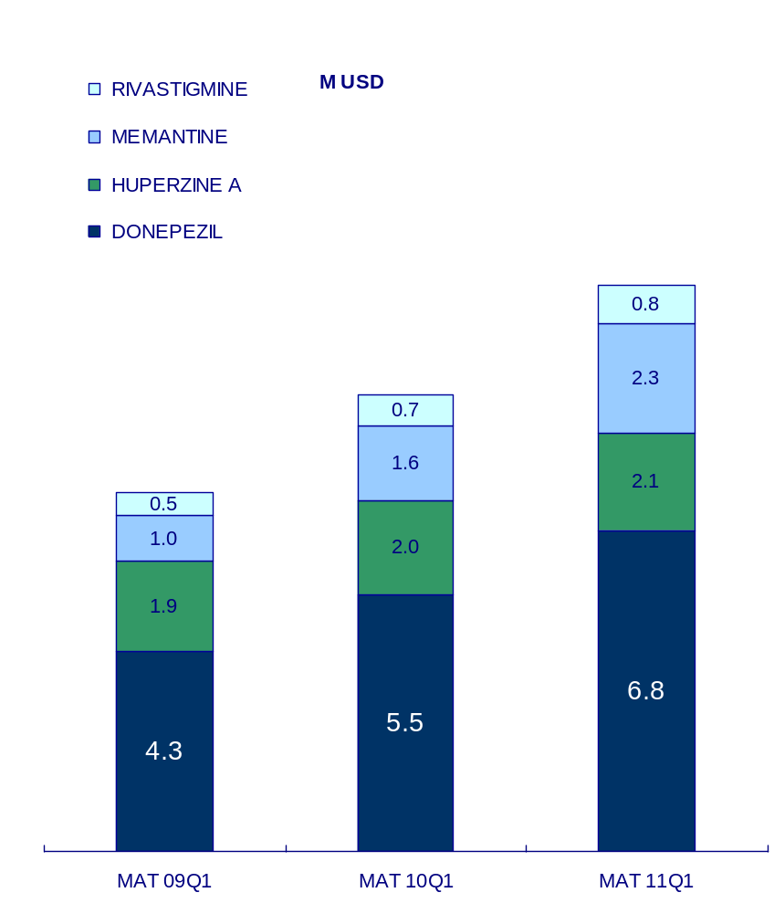
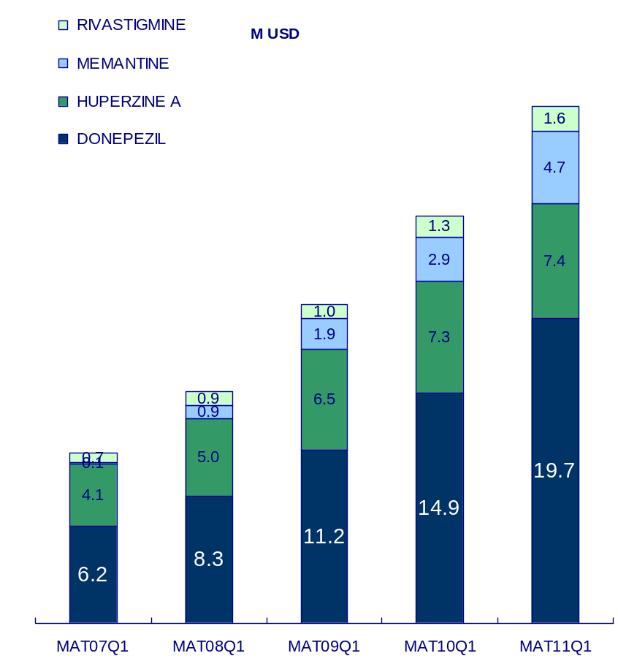
IMS&CPA Data
Alzheimer Disease Market National View
Alzheimer Market in China got 32.0% CAGR in the last 5 years, which was lower than China market growth(32.2%). In MAT 10Q4, AD’s growth rate (27.1%) was higher than total China Pharma market (22.4%). TierⅢ Hospitals achieved 12.1 M USD sales (36.1% of AD market) and 23.9% MAT growth rate, which lower than that of total AD market.
IMS
*TierⅢ Hospitals
33.5
+27.1%
CAGR(MAT 09Q1-MAT 11Q1): +25.7%
12.1
CAGR(MAT 07Q1-MAT 11Q1): +32.0%
+23.9%
26.3
+27.6%
9.7
20.6
+27.5%
+37.7%
7.6
15.0
+35.9%
11.0
Source: IMS CHPA 11Q1 Market definition: HUPERZINE A+N07D
*TierⅢ hospitals= CPA

Slide 20
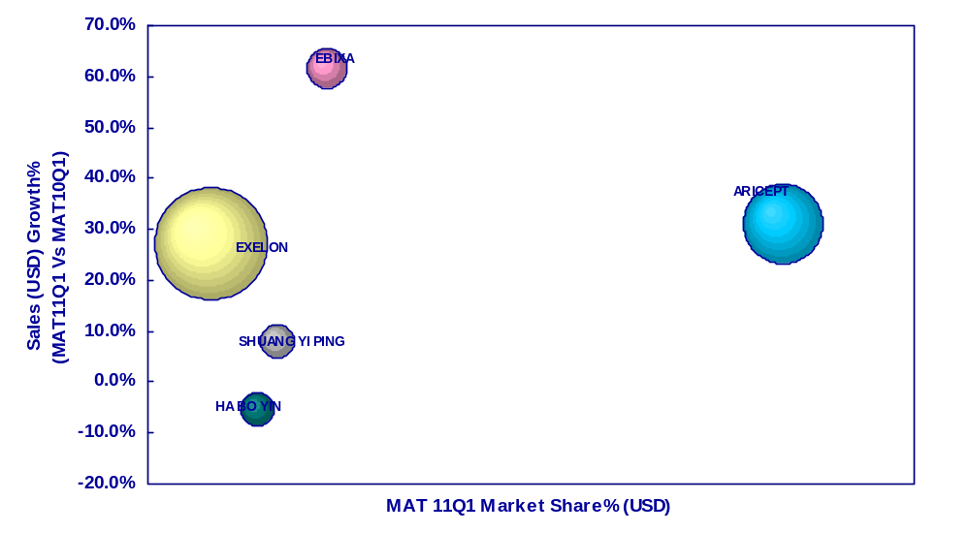
IMS Data
Alzheimer Disease Market National View
In MAT11Q1, Ebixa (61.4%), Aricept (30.9%) and Exelon(27.1%) growth rate exceeded AD average market growth (27.1%), and Aricept was the No.1 brand (49.7%) in AD market.
Ave Mkt Growth:+27.1%
Source: IMS CHPA 11Q1 Market definition: HUPERZINE A+N07D

Slide 21
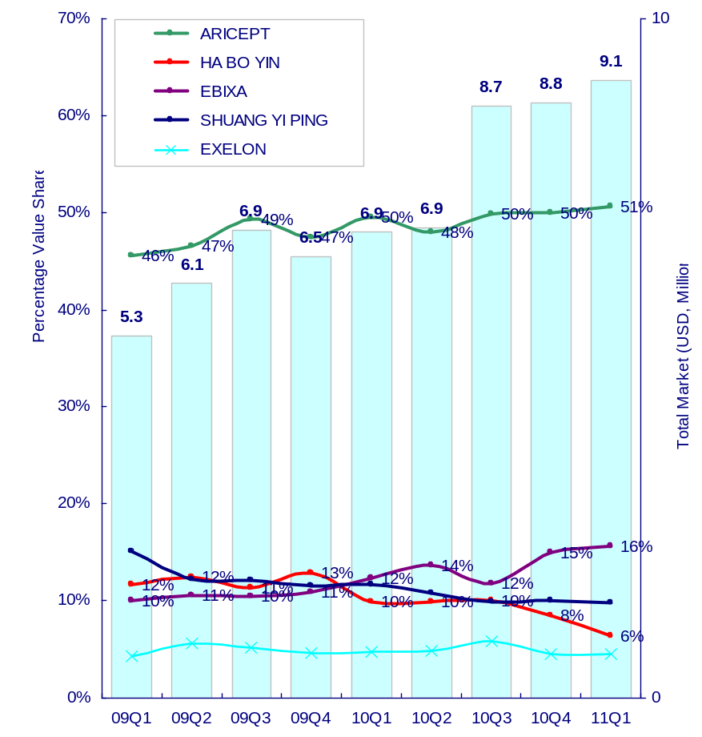
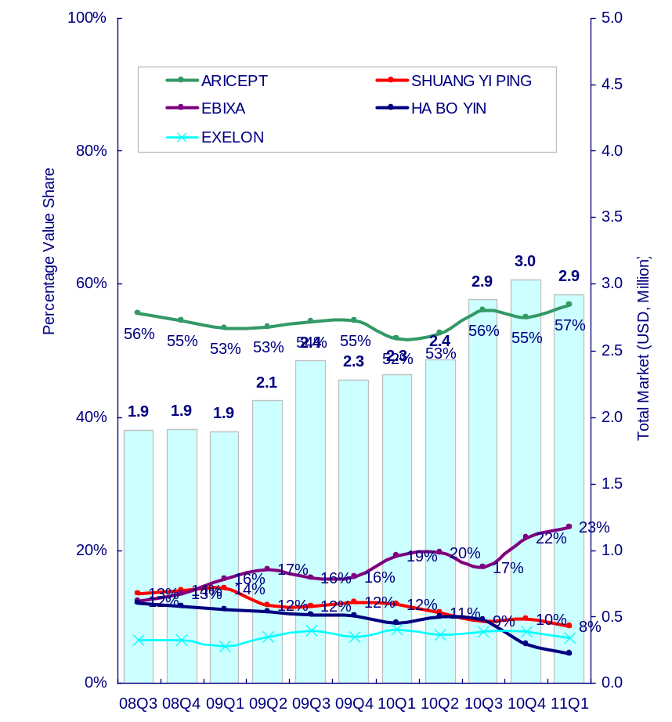
IMS&CPA Data
Alzheimer Disease Market National View
From the product view, ARCEPT still dominated China AD market as 51% value share in 11Q1. EBIXA had better performance in Tier III hospitals (CPA: 23%) than its national (IMS: 16%) and kept No.2 sale value brand from 09Q1 in Tier III.
IMS
*TierⅢ Hospitals
Source: IMS and CPA 11Q1 Market definition: HUPERZINE A+N07DN
*TierⅢ hospitals= CPA

Slide 22
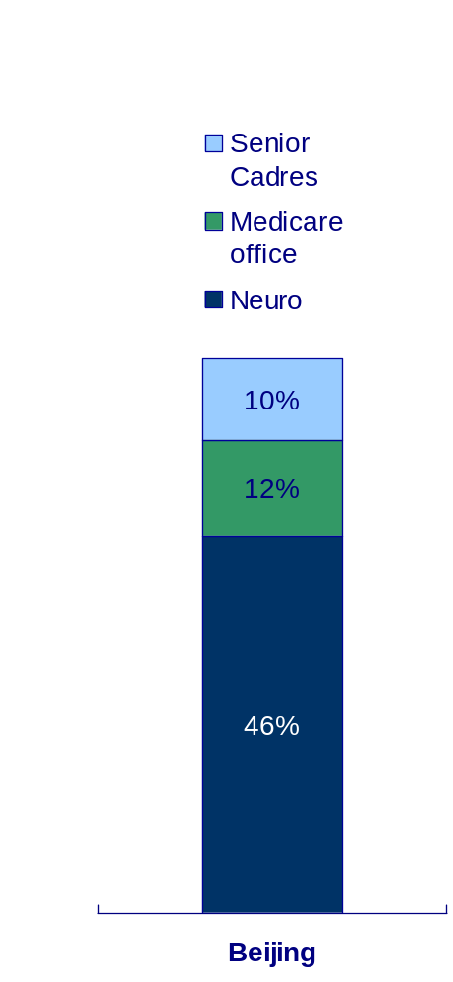
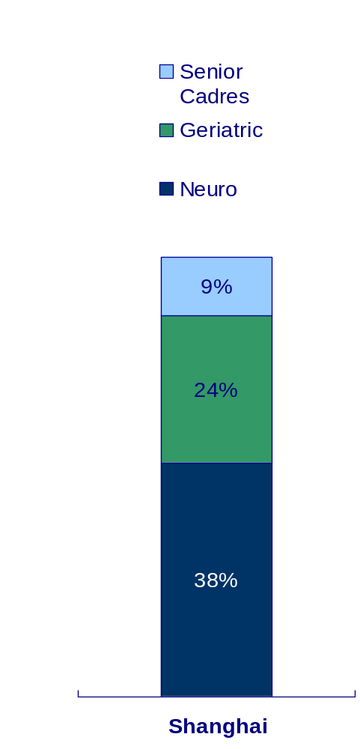
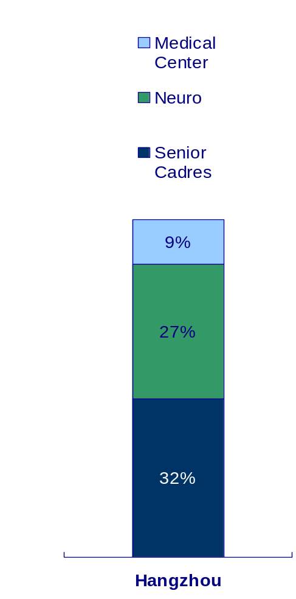
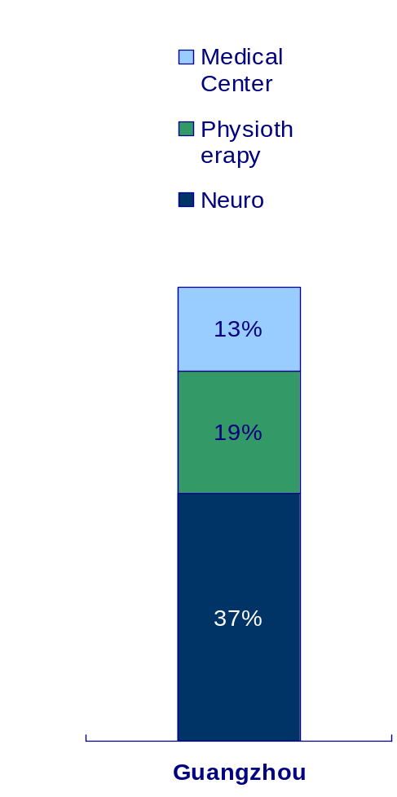
Rx. Data
Alzheimer Disease Rx View --- by Prescription
From the prescription data in sample hospitals of BJ, SH, GZ & HZ, the top 3 department accounted for over 60% prescription share, and Neuro was the No.1 department in all cities except Hangzhou.
未更新
Source: Rx MAT 10Q4 Market definition: HUPERZINE A+N07D

Slide 23
Rx Indication Data
Treatment Molecular Rx- ratio of target diagnosis AD
Molecule | Beijing, Guangzhou, Hangzhou | Shanghai
HUPERZINE A | 19.5% | 7.8%
DONEPEZIL | 23.4% | 12.8%
RIVASTIGMINE | 23.5% | 42.3%
MEMANTINE | 26.1% | 29.5%
Source: Rx Indication MAT09Q4

Slide 24
CML

Slide 25
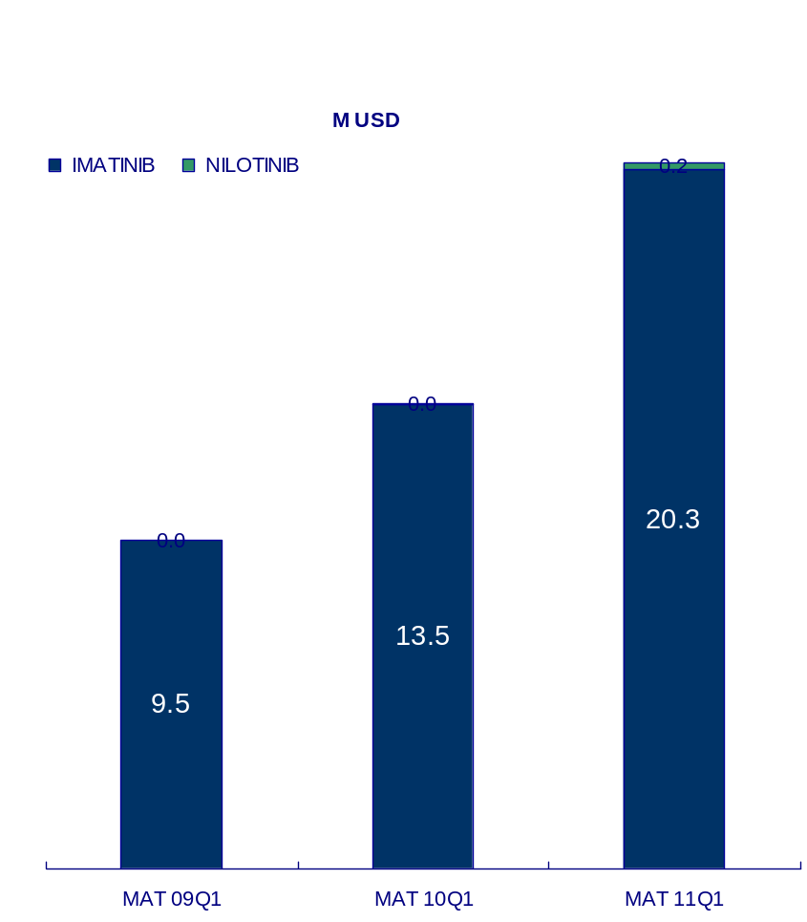
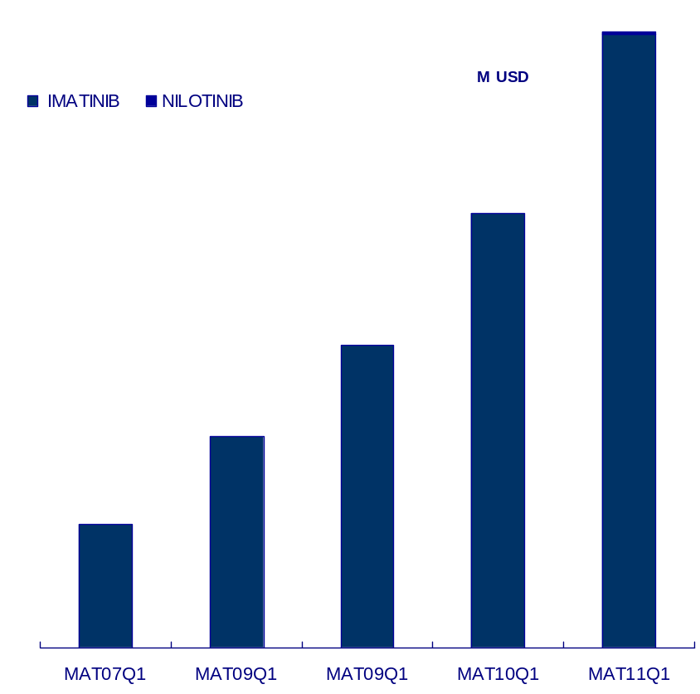
IMS&CPA Data
CML Market National View
AS the only treatment in CML, Glivec in China kept very high growth(49.7%) than China market growth(32.2%) in the last 5 years. In MAT11Q1, it reached 33.6 M USD value sales, and 41.7% annual growth vs. MAT10Q1 (total China Pharma market growth (22.4%)). TierⅢ Hospitals achieved 20.5 M USD sales (61.0% of CML market) and 51.7% MAT growth rate, which was higher than that of total CML market.
*TierⅢ Hospitals
IMS
33.6
20.5
+41.7%
+51.7%
CAGR(MAT 09Q1-MAT 11Q1): +46.5%
CAGR(MAT 07Q1-MAT 11Q1): +49.7%
23.7
13.5
+43.9.%
+41.5%
16.5
9.5
+43.3%
11.5
+72.0%
6.7
Source: IMS CHPA 11Q1 Market definition: IMATINIB + NILOTINIB
*TierⅢ hospitals= CPA

Slide 26
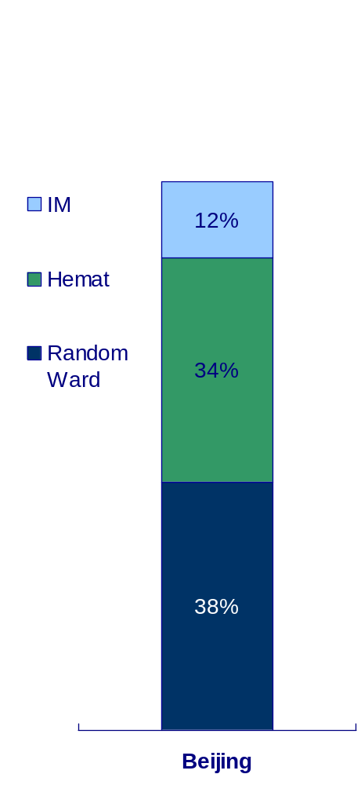
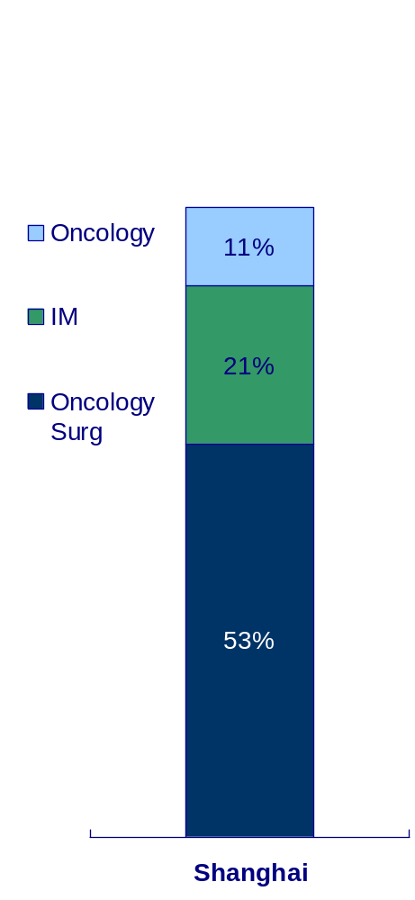
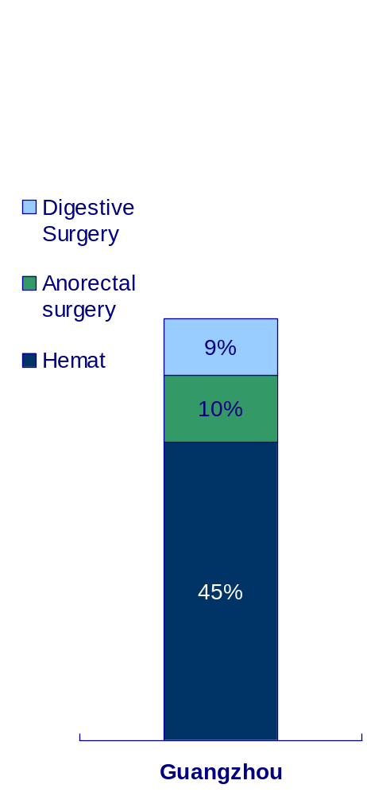
Rx. Data
CML Treatment Molecular Rx View --- by Prescription
From the prescription data in sample hospitals of BJ, SH and GZ, Random Ward (38%) and Hemato (45%) dominated the Glivec prescription in Beijing and Guangzhou respectively, while in Shanghai, Onco_Surg accounted for 53% prescription share in MAT10Q4.
未更新
Source: RX MAT 10Q4 Market definition: IMATINIB + NILOTINIB

Slide 27
Rx Indication Data
Treatment Molecular Rx- ratio of target diagnosis CML
Molecule | Beijing, Guangzhou, Hangzhou | Shanghai
IMATINIB | 75.6% | 50.0%
Source: Rx Indication MAT09Q4

Slide 28
HCV

Slide 29
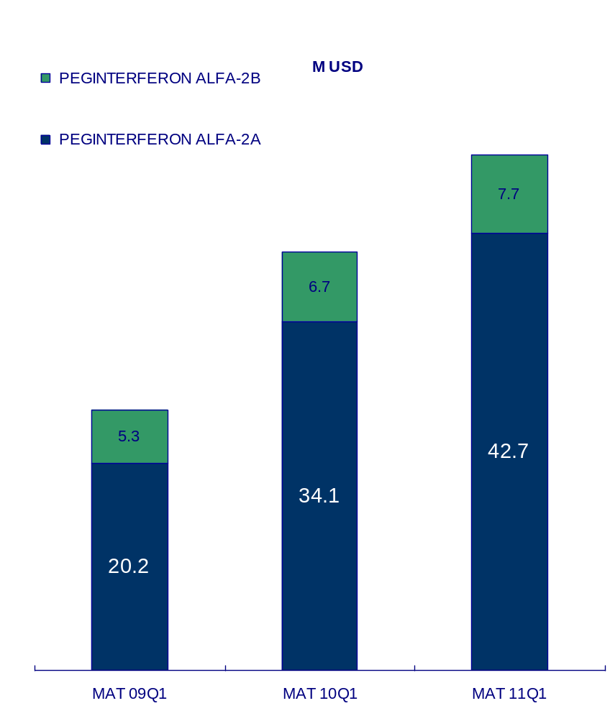
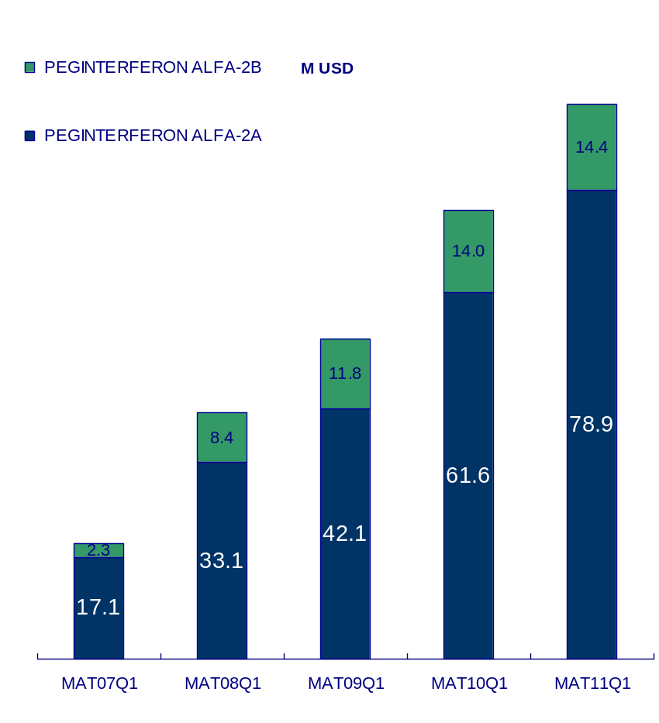
IMS&CPA Data
HCV Market National View
HCV Market kept much higher growth (48.1%) than the total China Pharma market growth (32.2%), and it had reached 93.4 M USD value sales in MAT 11Q1 and 23.5% annual growth (total China Pharma market growth 22.4%). Tier Ⅲ Hospitals achieved 40.0 M USD sales (42.8% of HCV market) and 16.8% MAT growth rate.
IMS
*TierⅢ Hospitals
93.4
40.0
+23.5%
CAGR(MAT 09Q1-MAT 11Q1): +29.1%
34.2
+16.8%
75.6
CAGR(MAT 07Q1-MAT 11Q1): +48.1%
+40.4%
53.9
+42.8%
+29.7%
24.0
41.5
+113.7%
19.4
*TierⅢ hospitals= CPA
Source: IMS and CPA 11Q1 Market definition: PEGINTERFERON ALFA-2A + PEGINTERFERONALFA-2B

Slide 30
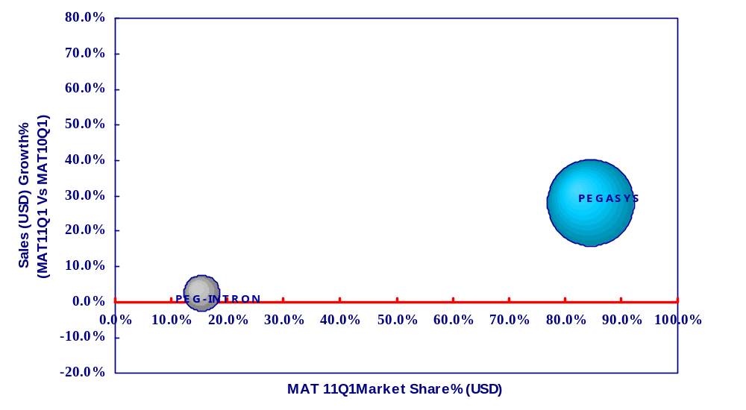
IMS Data
HCV Market National View
In MAT11Q1, Pegasys had better market share and growth rate (84.6% and 28.2%) than that of Peg-Intron (15.4% and 2.8%).
Ave Mkt Growth:+23.5%
Source: IMS CHPA 11Q1 Market definition: PEGINTERFERON ALFA-2A + PEGINTERFERONALFA-2B

Slide 31
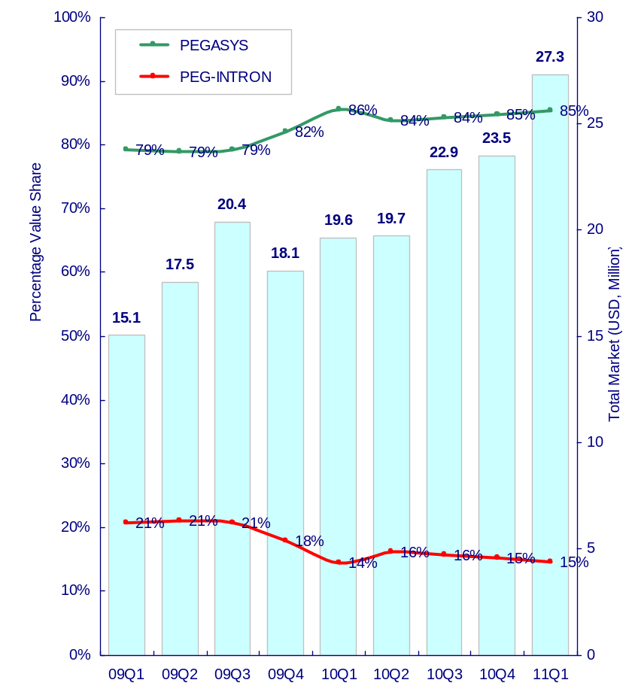
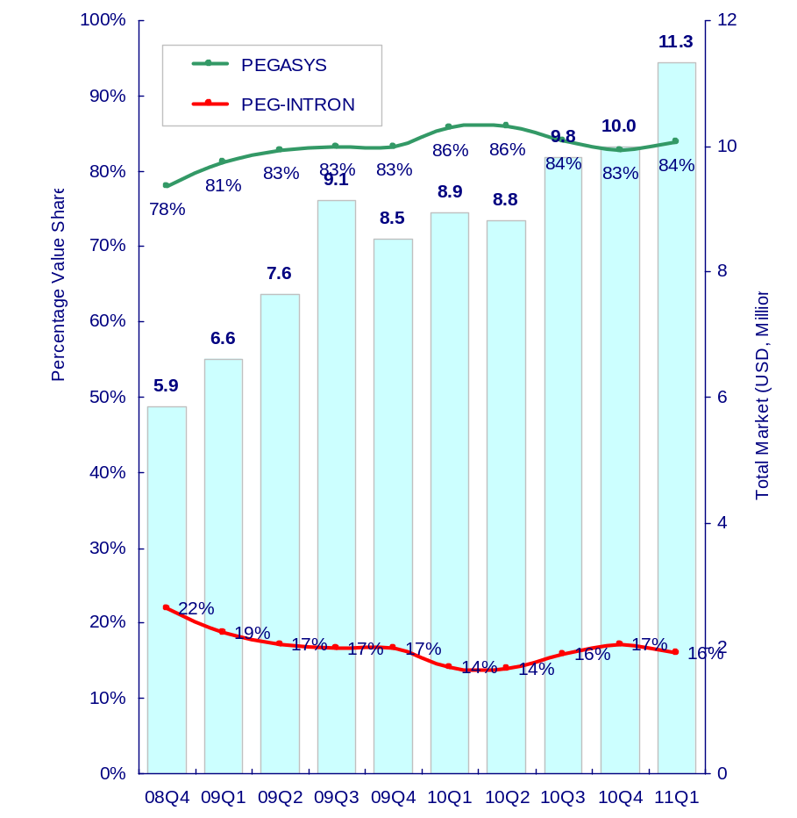
IMS&CPA Data
HCV Market National View
From the product view, in 11Q1, Pegasys achieved 85% share in IMS and 84% in CPA respectively.
IMS
CPA TierⅢ Hospitals
Source: IMS and CPA 11Q1 Market definition: PEGINTERFERON ALFA-2A + PEGINTERFERONALFA-2B

Slide 32
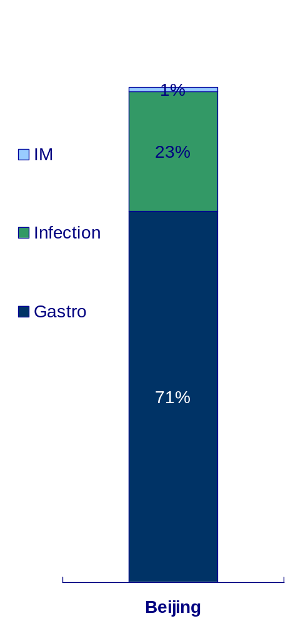
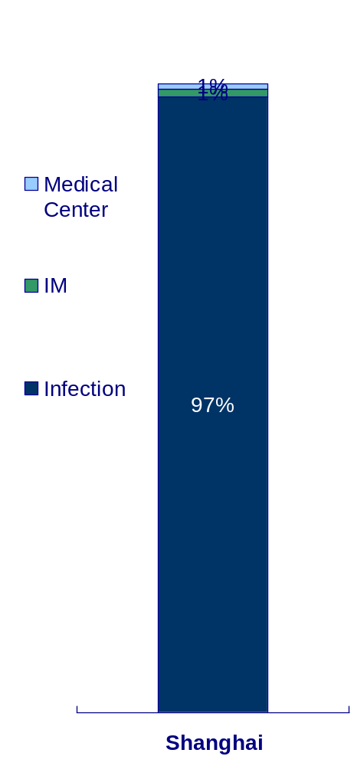
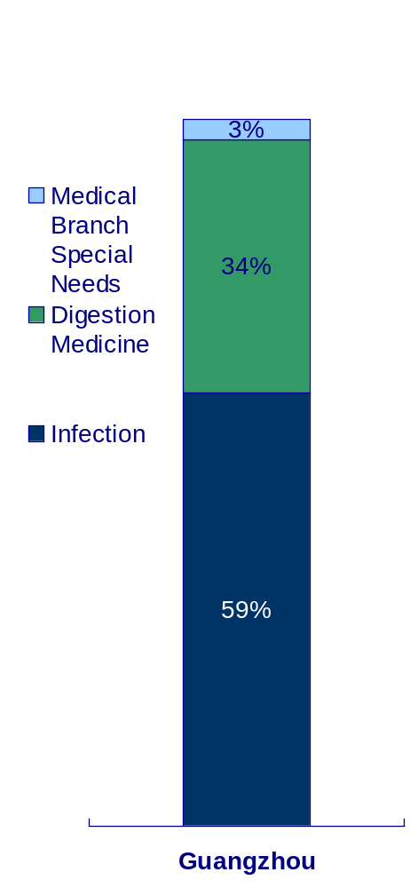
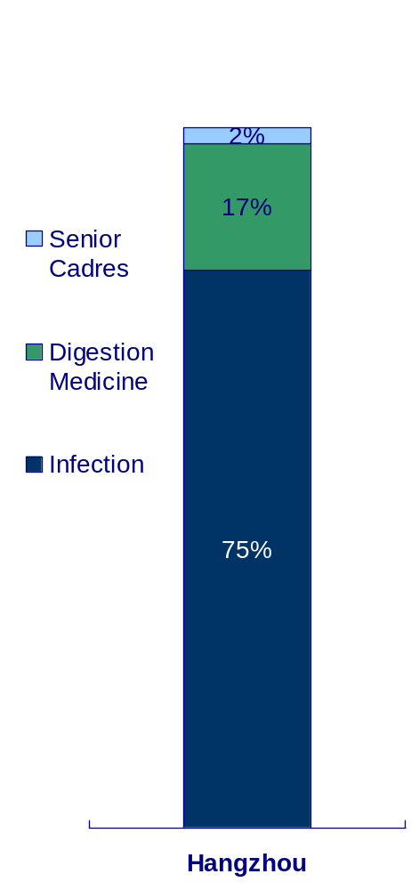
Rx. Data
HCV Treatment Molecular Rx View --- by Prescription
From the prescription data in sample hospitals of BJ, SH, GZ & HZ, Infection dominated the HCV molecular prescriptions in SH, GZ and HZ, while in BJ Gastro was the No.1 department and accounted for 71% prescription share in MAT 10Q4.
未更新
Source: RX MAT 10Q4 Market definition: PEGINTERFERON ALFA-2A + PEGINTERFERONALFA-2B

Slide 33
Rx Indication Data
Treatment Molecular Rx- ratio of target diagnosis HCV
Molecule | Beijing, Guangzhou, Hangzhou | Shanghai
PEGINTERFERON ALFA-2A | 98.2% | 99.1%
PEGINTERFERON ALFA-2B | 92.3% | 95.0%
Source: Rx Indication MAT09Q4

Slide 34
NIAD

Slide 35
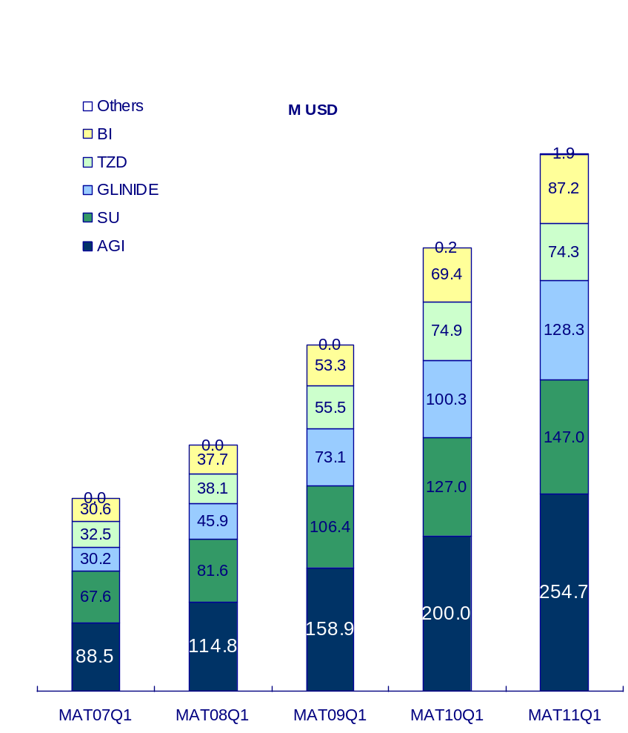
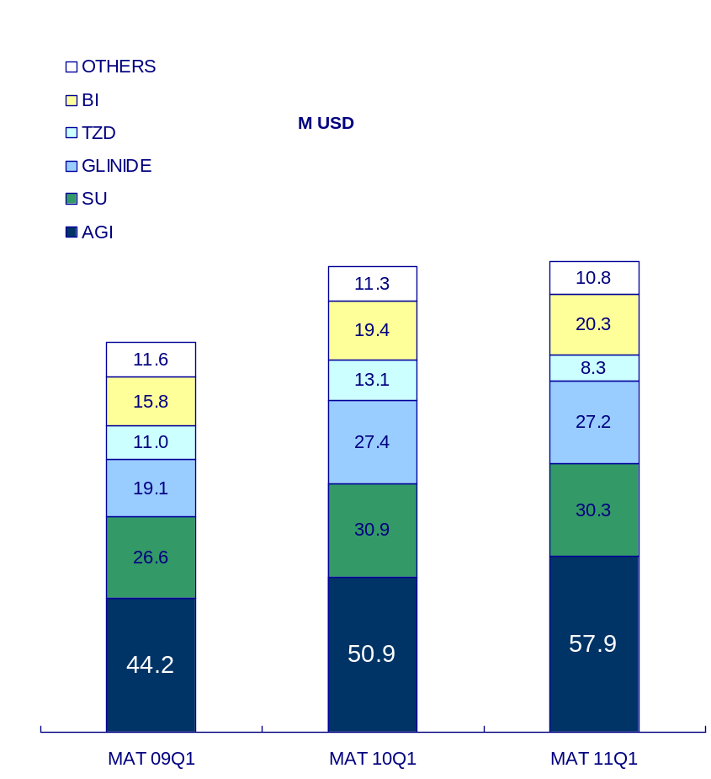
IMS&CPA Data
NIAD Market National View
NIAD Market in China got 29.1% CAGR in the last 5 years, which was lower than China market growth(32.2%), and it reached 693.4 M USD value sales, and 21.3% annual growth (total China Pharma market growth (22.4%). Tier Ⅲ Hospitals achieved 154.8 M USD sales (22.3% of NIAD market) and 1.2% MAT growth rate, which was much lower than that of total market.
IMS
CPA TierⅢ Hospitals*
693.4
+21.3%
CAGR(MAT 09Q1-MAT 11Q1): +9.9%
571.8
+1.2%
CAGR(MAT 07Q1-MAT 11Q1): +29.1%
153.0
154.8
+27.9%
+19.3%
447.1
128.2
+40.5%
+27.5%
318.1
249.5
*TierⅢ hospitals= CPA
Source: IMS and CPA 10Q4 Market definition: Non Insulin Anti Diabetes
OTHERS*: SULPHONYLUREA A-DIABS, TZD FDC, SU/MET FDC

Slide 36
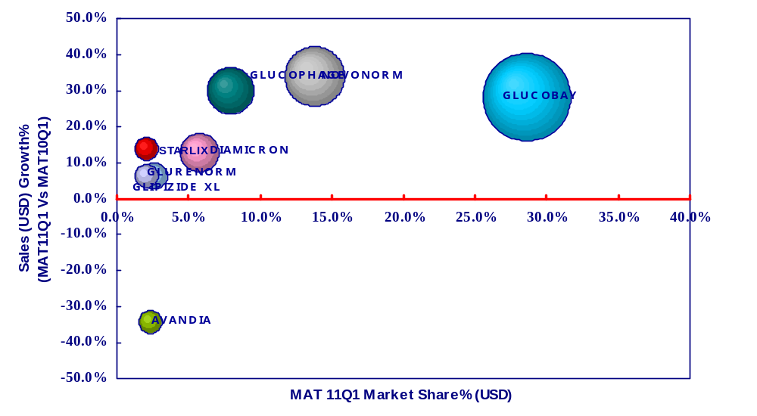
IMS Data
NIAD Market National View
In MAT11Q1, AMARYL had the highest growth rate (50.9%) in NIAD market, and Glucobay was still the leading brand (28.7%) in MAT 11Q1.
Ave Mkt Growth:+21.3%
Source: IMS and CPA 11Q1 Market definition: Non Insulin Anti Diabetes

Slide 37
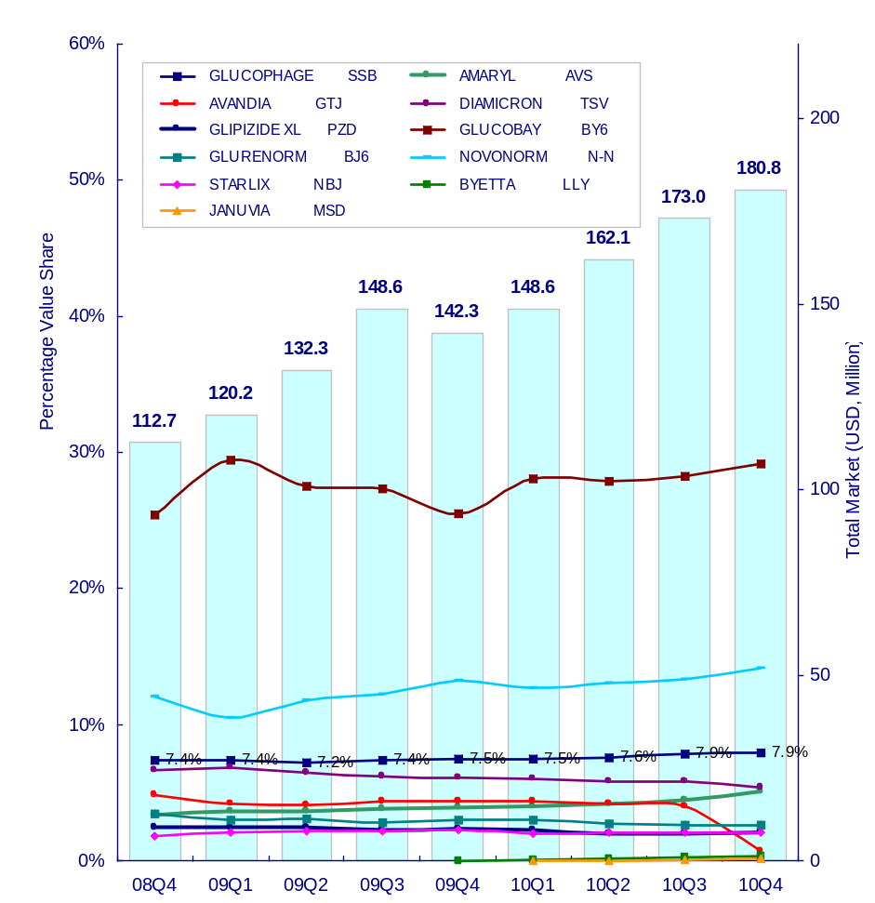
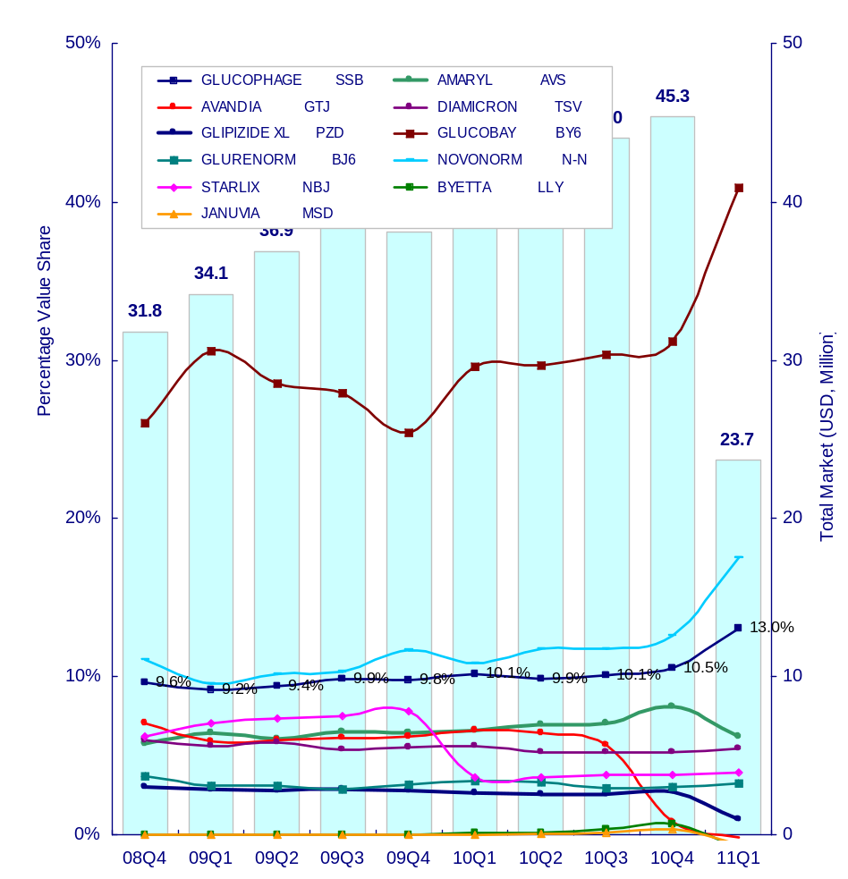
IMS&CPA Data
Key NIAD Product Group？
From the product view, Glucobay was still the No.1 brand with 29% value share in 10Q4. Glucophage had better performance in TierIII hospitals (CPA, 11% ) than whole market (IMS, 8%).
IMS
CPA TierⅢ Hospitals
无11Q1数据
Source: IMS and CPA 10Q4 Market definition: Non Insulin Anti Diabetes

Slide 38




Rx. Data
NIAD Treatment Rx View --- by Prescription
From the prescription data in sample hospitals of BJ, SH, GZ & HZ, the top treatment depts. were Endo, Cardi and IM.
未更新
Source: Rx MAT 10Q4 Market definition: Non Insulin Anti Diabetes

Slide 39
Rx Indication Data
Treatment Molecular Rx- ratio of target diagnosis NIAD
Molecule | Beijing, Guangzhou, Hangzhou | Shanghai
GLIBENCLAMIDE | 76.4% | 55.3%
METFORMIN | 68.2% | 62.3%
GLICLAZIDE | 60.2% | 58.5%
GLIPIZIDE | 65.7% | 64.1%
GLIQUIDONE | 61.7% | 66.5%
ACARBOSE | 60.1% | 62.2%
VOGLIBOSE | 64.3% | 69.6%
REPAGLINIDE | 72.1% | 76.6%
GLIMEPIRIDE | 75.6% | 82.4%
ROSIGLITAZONE | 67.9% | 83.1%
PIOGLITAZONE | 78.0% | 87.3%
NATEGLINIDE | 63.9% | 60.9%
Source: Rx Indication MAT09Q4

Slide 40
RA

Slide 41


IMS&CPA Data
RA Market National View
RA Market kept higher growth (486.7%) than the total China Pharma market growth (32.2%) in the last 5 years, and it reached 51.9 M USD value sales, and 40.5% annual growth (total China Pharma market growth (22.4%). Tier Ⅲ Hospitals achieved 27.3 M USD sales (52.6% of RA market) and 29.7% MAT growth rate, which was lower than that of total RA market.
IMS
*TierⅢ Hospitals
51.9
27.3
+40.5%
+29.7%
CAGR(MAT 09Q1-MAT 11Q1): +45.2%
36.9
21.0
+56.0%
CAGR(MAT 07Q1-MAT 11Q1): +128.1%
+62.6%
23.7
12.9
+110.5%
11.3
+486.7%
1.9
*TierⅢ hospitals= CPA
Source: IMS and CPA 11Q1Market definition: Target Therapy

Slide 42

IMS Data
RA Market National View
In MAT11Q1, Yi Sai Pu was the No.1 brand (68%) while Remicade had the best annual growth rate (46.2%).
Ave Mkt Growth:+44.3%
Source: IMS 11Q1 Market definition: Target Therapy

Slide 43


IMS&CPA Data
RA Market National View
From the product view, in 11Q1 Yi Sai Pu still dominated the market (76% in IMS and 69% in CPA), while it was eroded by Remicade from 70% value share in 09Q1.
IMS
*TierⅢ Hospitals
*TierⅢ hospitals= CPA
Source: IMS and CPA 11Q1 Market definition: Target Therapy

Slide 44




Rx. Data
RA Treatment Molecular Rx View --- by Prescription
From the prescription data in sample hospitals of BJ, SH, GZ & HZ, Rheumahe dominated the RA prescriptions in BJ, SH and GZ in MAT10Q4, while in HZ, Gastro gain 47% prescription share, which was a little higher than Rheuma (30%).
未更新
Source: RX MAT 10Q4 Market definition: Target Therapy

Slide 45
Rx Indication Data
Treatment Molecular Rx- ratio of target diagnosis RA
Molecule | Beijing, Guangzhou, Hangzhou | Shanghai
HUMAN TNF-0 RECEPTOR II: IG G FC FUSION PROTEIN | 37.2% | 37.2%
INFLIXIMAB | 42.4% | 42.4%
Source: Rx Indication MAT09Q4

Slide 46
HCC

Slide 47


IMS&CPA Data
HCC Market National View
HCC Market kept higher growth(326.0%) than the total China Pharma market growth(32.2%), it reached 17.1 M USD value sales, and -2.5% decline vs. (total China Pharma market growth (22.4%). CPA achieved 9.4 M USD sales (50.5% of HCC market) and 13.4 % MAT growth rate, which was higher than that of total HCC market.
IMS
CPA TierⅢ Hospitals
CAGR(MAT 09Q1-MAT 11Q1): +14.8%
9.4
17.5
-2.5%
+13.4%
17.1
8.3
+16.2%
+42.3%
7.1
CAGR(MAT 07Q1-MAT 11Q1): +326.0%
12.3
+90.1%
6.5
0.1
+12384.6%
*TierⅢ hospitals= CPA
Source: IMS and CPA 11Q1 Market definition: Target Therapy
Note: the sales has been adjusted into HCC sales

Slide 48

IMS Data
HCC Market National View
In MAT11Q1, NEXAVAR dominated the target market and got -2.5% decline compared with MAT10Q1.
Ave Mkt Growth:--2.6%
Source: IMS 11Q1 Market definition: Target Therapy
Note: the sales has been adjusted into HCC sales

Slide 49


IMS&CPA Data
HCC Market National View
From the product view, NEXAVAR dominated the market.
IMS
CPA TierⅢ Hospitals
Source: IMS and CPA 11Q1 Market definition: Target Therapy
Note: the sales has been adjusted into HCC sales

Slide 50




Rx. Data
HCC Treatment Molecular Rx View --- by Prescription
From the prescription data in sample hospitals of BJ, SH, GZ & HZ, the top1 treatment Dept. of HCC molecular prescriptions was Digestive Surgery.
未更新
Source: RX MAT 10Q4 Market definition: Target Therapy
Note: the prescription has been adjusted into HCC prescription

Slide 51



Rx Indication Data
HCC Treatment Department Allocation*
In 10Q2,for HCC treatment, still Hepa-related surgery department and intervention department stand very important as in the top3 Rx.Regarding lagged Hepa-related oncology, we estimate HCC patients is only a small proportion among their patients pool.
General Hospital
Oncology Hospital
Infectious Hospital
(mainly focus on Tier III general hospital, also include a few infectious hospital)
(only includes oncology specialized hospital)
(only includes infectious specialized hospital)
未更新

Slide 52



Rx Indication Data
HCC Treatment Choice
The same as 10Q1,MTT is relatively higher Rx share in the Depts. in oncology hospitals comparing with the same ones in other hospitals, especially in intervention department. For general hosptial and infectious hospitals, Hepa-related oncology department is key battlefield although the MTT share in less than 5%.
General Hospital
Oncology Hospital
Infectious Hospital
(mainly focus on Tier III general hospital, also include a few infectious hospital)
(only includes oncology specialized hospital)
(only includes infectious specialized hospital)
未更新
2010Q1Q2
2010Q2
2010Q2

Slide 53
Rx Indication Data
HCC Prescription share
No matter what type of hospital is, Sorafenib is highly prescribed for HCC treatment. Also in General hospital, A certain proportion of Cetuximab is used for HCC rather than Oncology hospital and infectious hospital. Sunitinib’s prescription mainly contributes to other diseases but not HCC.
Hospital type |  | a.MAT2010A Prescriptions (total) | b.MAT2010A Prescriptions (HCC related) | c.HCC related Prescription share
 | Molecule |  |  | c=b/a
 | Cetuximab | 37 | 8 | 22%
 | Sorafenib | 58 | 43 | 74%
 | Sunitinib | 22 | 0 | 0
 | Nimotuzumab | 27 | 2 | 7%
 | Cetuximab | 326 | 8 | 2%
 | Sorafenib | 229 | 156 | 68%
 | Sunitinib | 123 | 2 | 2%
 | Nimotuzumab | 275 | 7 | 3%
 | Cetuximab | 38 | 0 | 0
 | Sorafenib | 79 | 63 | 80%
 | Sunitinib | 33 | 0 | 0
 | Nimotuzumab | 4 | 0 | 0
General Hospital
Oncology Hospital
未更新
Infectious Hospital

Slide 54
Rx Indication Data
HCC Treatment Molecular Rx- ratio of target diagnosis
Molecule | Beijing, Guangzhou, Hangzhou | Shanghai
SORAFENIB | 50.7% | 50.7%
SUNITINIB | 0.00% | 0.00%
Source: Rx Indication MAT09Q4

Slide 55
Appendix

Slide 56
BMS 10 Key Therapy Area Market Definitions
Disease Area
Therapy Class Definitions
Disease Area
Therapy Class Definitions
1. Affective & Psychiatric Dis | N5A | Antipsychotics
 | N5B | Hypnotics/Sedatives
 | N5C | Minor Tranquilizers
 | N6A | Antidepressants
 | N6B | Psychostimulants
 | N6C | Psycholeptics/Psychoanaleptics
 | N7B | Antismoking Drugs
 | N7E | Drugs for Alcohol Dependence
 | N7F | Drug Dependence Products
 | N7X | All Other CNS Drugs
2. Alzheimer’s Disease | N7D | Anti-Alzheimer’s Products HUPERZINE A
3. Altherosclerosis/Thrombo | B1A | Non-Inj Anticoagulants
 | B1B | Injectable Anticoagulants
 | B1C | Platelet Aggregate Inhibitors
 | B1D | Fibrinolytics
 | B1E | Direct Thrombin Inhibitors
 | B1X | Other Antithrombotic Agents
 | C4A | Cereb/Vaso Therapeutics
 | C10 | Chlosterol Reducers
 | C11 | Cholesterol Reducers Combos
4. Diabetes | A10B |  | Oral Antidiabetics
 | A10C |  | Human Insulin
 | A10D |  | Animal Insulin
 | A10E/X |  | Insulin Devices, all Other
5. Hepatitis | J5B |  | Non-HIV Antivirals: Hepsera,
 | Rebetol, Robatrol, Zeffix, Actimmune,
 | Baraclude, Infergen, Pegasys, Viraferon Peg and Virazole only
 | L3B |  | Interferons: Alfaferon, Alfater,
 | Cileferon A, Feron, IFN Alpha, IFN Beta,
 | Intron A , Rebetron,
 | Sumiferon, and Roferon A only
6. HIV | J5C | HIV Antivirals
7. Obesity | A8A | Obesity Products
8. Oncology | L1 | Non-Hormonal Cytostatics
 | L2 | Hormonal Oncology
9. Rheumatoid Arthritis | M1C | Special Antirheumatics
 | L4A | Immunosuppressants, Remicade
 |  | only
 | L1B | Antimetabolites: Methotrexate only
10. Solid Organ Transplant | L4A | Immunosuppressants: All except
 |  | Remicade

Slide 57
Market definition
Group | Market definition | Group | Market definition
ACS | ACETYLSALICYLIC ACID | CML | IMATINIB
 | BERAPROST | HCV | PEGINTERFERON ALFA-2A
 | TIROFIBAN |  | PEGINTERFERON ALFA-2B
 | CLOPIDOGREL | NIAD | GLIBENCLAMIDE
 | SARPOGRELATE |  | METFORMIN
 | OZAGREL |  | GLICLAZIDE
 | CILOSTAZOL |  | GLIPIZIDE
 | TICLOPIDINE |  | GLIQUIDONE
 | SULODEXIDE |  | ACARBOSE
 | BATROXOBIN |  | VOGLIBOSE
AF&VTE/P | ACETYLSALICYLIC ACID |  | REPAGLINIDE
 | HEPARIN |  | GLIMEPIRIDE
 | WARFARIN |  | ROSIGLITAZONE
 | NADROPARIN CALCIUM |  | PIOGLITAZONE
 | NADROPARIN CALCIUM |  | NATEGLINIDE
 | ENOXAPARIN SODIUM | RA | HUMAN TNF-0 RECEPTOR II: IG G FC FUSION PROTEIN
 | TICLOPIDINE |  | INFLIXIMAB
 | RIVAROXABAN | HCC | SORAFENIB
AD | HUPERZINE A |  | SUNITINIB
 | DONEPEZIL
 | RIVASTIGMINE
 | MEMANTINE

Slide 58
HCC Hospital Type Definition
In Rx General indication data,34 hospitals are covered from only 2 cities : Beijing(BJ), Hangzhou(HZ);
In Rx Oncology indication data, 50 hospitals are covered, from 6 cities: Beijing(BJ), Shanghai(SH), Guangzhou(GZ), Tianjin(TJ), Hangzhou(HZ), Chengdu(CD); including a few general hospitals and oncology specialized hospitals.
In Rx Infectious indication data, totally 13 hospitals are covered, from 11 cities.
Rx general indication data are submitted every half year, Rx oncology/infectious indication data are submitted every quarter.
Rx indication data includes hundreds of departments, in order to make sense of analysis, we integrated those departments into 21 departments according to their prescription practice. As for HCC, we selected 7 major departments for comparison as Hepatology, Hepa-related Surgery , Hepa-related Oncology, Intervention, GI, TCM and infectious.
All of the illustrations base on “prescription share” in the following slides.
From Rx indication data, we can’t differentiate HCC from Liver Cancer, thus all the analysis grounds on the liver cancer.
Any bias will probably be existent due to limited hospitals involvement.

